Slide 1




Mind . Like . Water

Slide 2
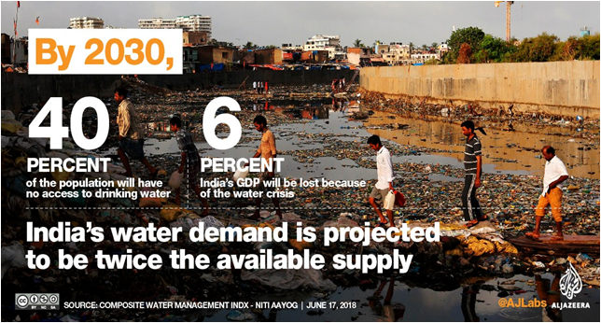
Water - the Elixir of Life - is Dying
Water scarcity is a BIG problem
Globally: 50% of Earth’s population in 2050 will live in drought.
In India: In 11 years, Demand is going to be DOUBLE available supply of water

Slide 3
Causes
Growing Population
Adverse Environmental Conditions
But most importantly wastage of water!
According to the survey , From “The Hindu”
a human being waste 15-60 liters of water unnecessarily per day
30*365=10,950 liters(on an average)which is equal to 7,300 -12,000litres of water per year.

Slide 4
Why?
Consumption data is available only at a very high level.
Data collection systems are limited in their coverage, robustness and efficiency.
Data collection procedures & tools are technologically outdated, unreliable and not in real time.
Eg: 30 days is the average time it takes to find and fix a leak in a water pipe for any city department

Slide 5
What did we do?
“ What gets Measured gets Managed “
Define consumer profiles
Measure water consumption
Deduce optimum water usage metrics per customer
Help authorities to Negatively Incentivize the wastage

Slide 6
Who uses/needs this ?
Housing societies & gated communities
Apartments blocks
Industrial Areas
Water Distribution & Management Departments of Cities
Facilities Management Companies

Slide 7
What did we build?
An IoT-enabled Water Meter
A Mobile App for review, monitor and control flow
Cloud storage of consumption data
Web App to monitor aggregate consumption data

Slide 8
How does it work?
Step 1:
Devices are installed at the consumer points
Step 2:
Register users
Step 3:
End user uses app
Step 4:
Society manager aggregates Consumption
Consumption Data is stored in cloud. Insights derived on standard metrics.

Slide 9

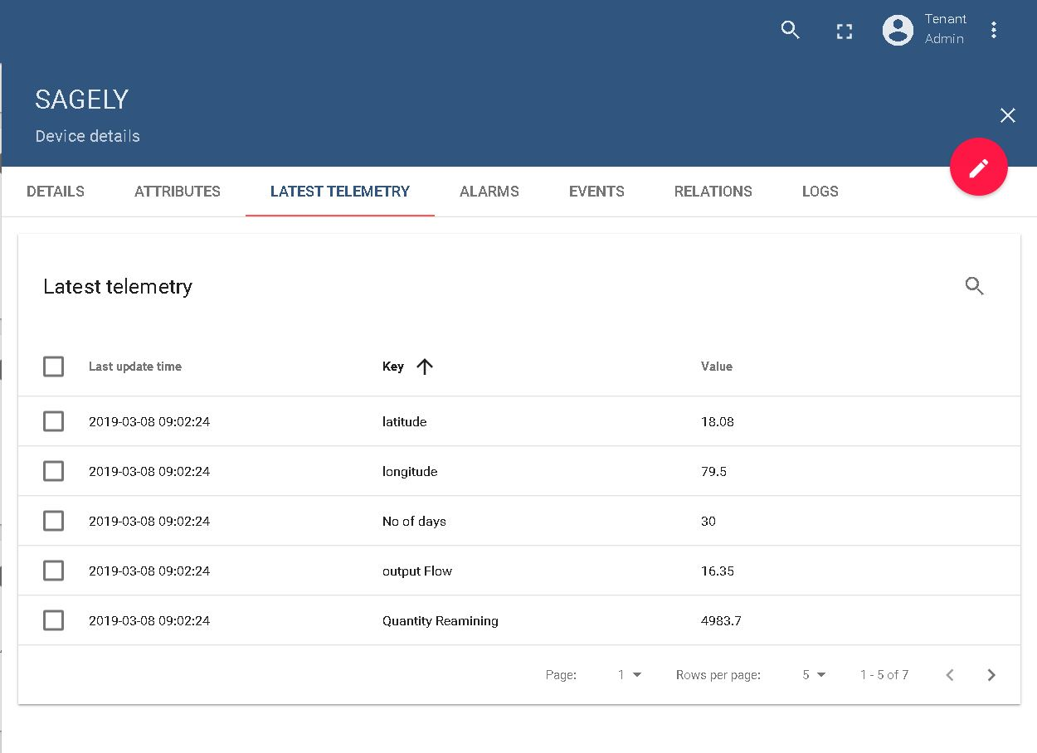
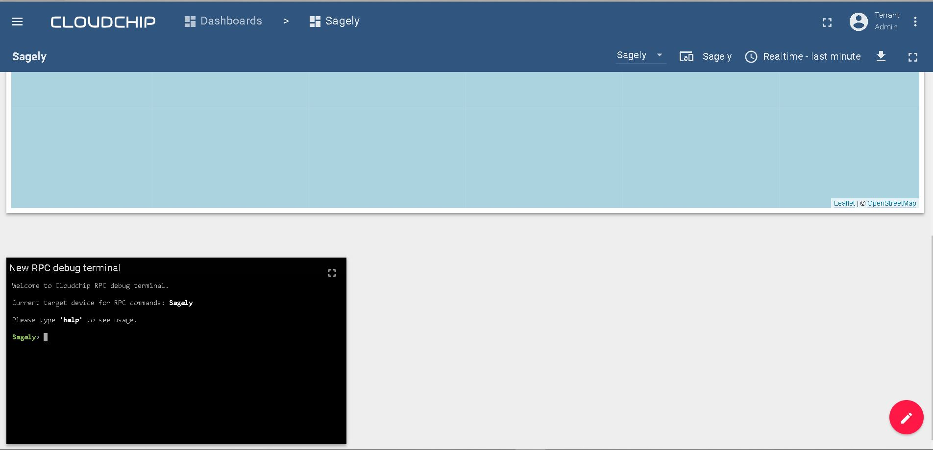
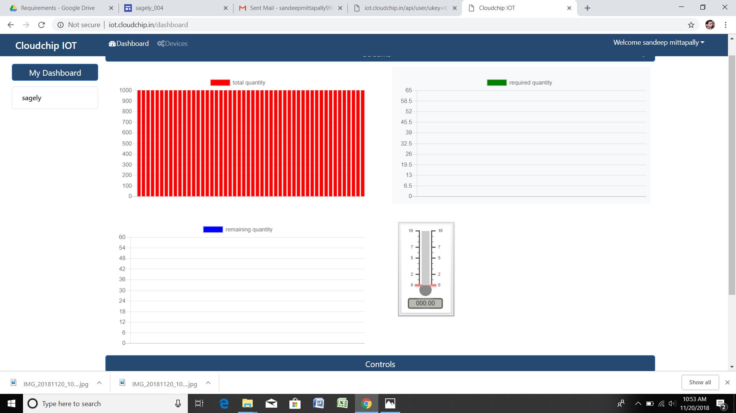
Does it work?

Slide 10

Show Me
Video
Notes:
Attach the video here

Slide 11
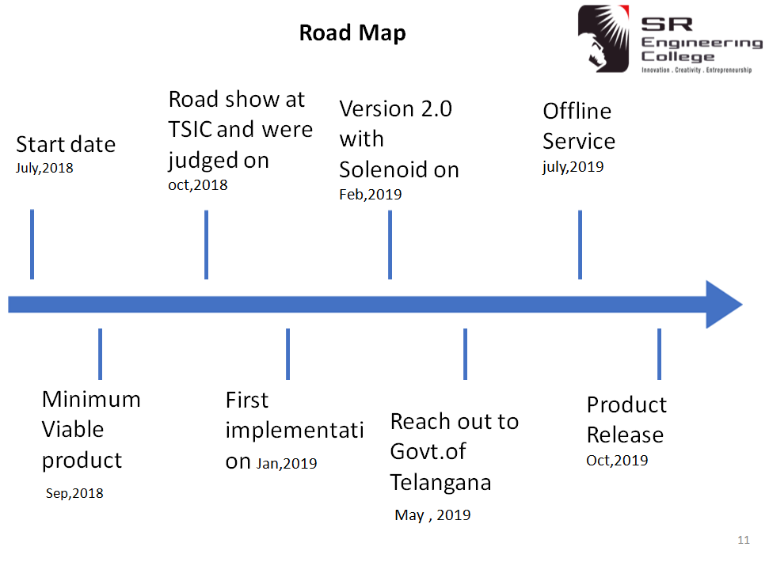
Where are you in your journey?
Completed our pilot testing individual houses and apartments.
Notes:
Attach road map image

Slide 12
How will they know about you?
Direct Sales to Gated Communities and Apartment Blocks
Reseller Agreements with existing meter channel partners
Social Media Marketing

Slide 13
How many need this?
Growth in Housing Sector
Growth of Apartments has been increased to 55% in Hyderabad.
Smart City Initiatives
India have initiated to develop 100 smart cities in which this device will be useful.
Global focus on Water Scarcity

Slide 14
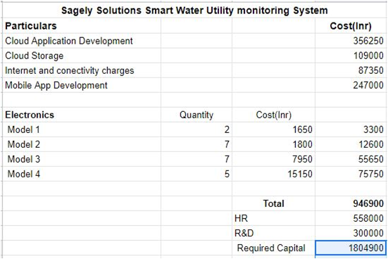
Cut a cheque for?

Slide 15
And we are...
P. Shashi Preetham,4th Year , ECE
Polneni SriVidya,3rd Year , CSE
Sandeep Mittapally,3rd Year , ECE

Slide 16
Are you hacking this alone?
Ofcourse not! We have our Mentors and Advisors:
Sreedevi Devireddy, CEO - SRiX
Raj Samala, Founder - Revalsys
Ravi Devulapally, Vice President - Technology & Business Incubation, SRiX
Narsimulu Cinasi, Manager - IoT & ESDM Center, SRiX

Slide 17
Thank You!
“If there is magic on this planet, it is contained in water.” Loren Eiseley

